Slide 1
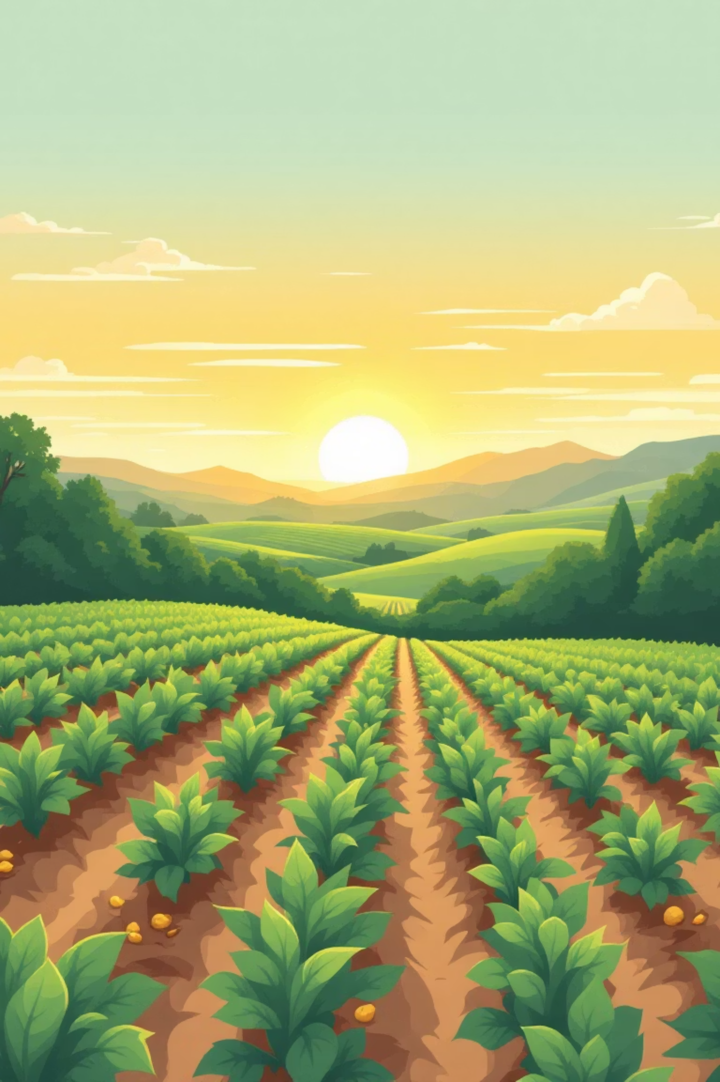
Potato Disease Prediction Using Machine Learning
Detecting potato leaf diseases early with AI
ADITYA SINGHEnrollment / Roll No: S24CSEU2779Bennett University, CSE, 3rd Semester

Slide 2



Introduction to Potato Crops
What are Potato Crops?
Why are They Important?
What is a Plant Disease?
Potatoes are a staple food worldwide, grown in many countries. They are a primary source of carbohydrates and essential nutrients, feeding billions.
Potatoes are crucial for food security and farmer livelihoods. Healthy crops mean better yields, more income for farmers, and stable food supplies.
A plant disease is any condition that harms a plant's health, often caused by fungi, bacteria, or viruses, leading to reduced growth or yield.

Slide 3
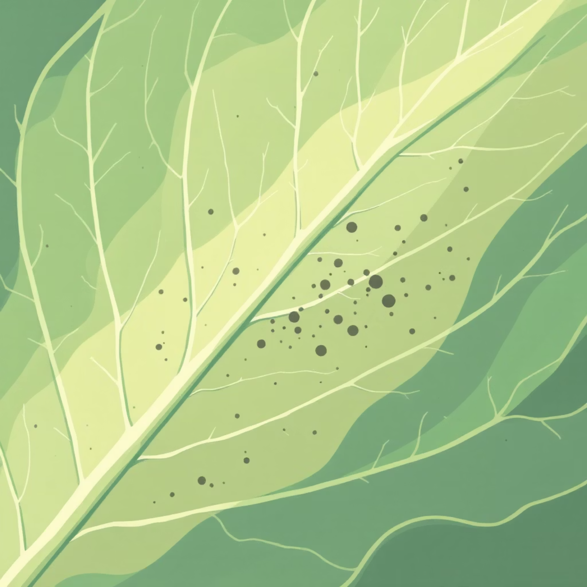
The Problem: Undetected Potato Diseases
Hidden Threat: Farmers struggle with various potato leaf diseases that are hard to spot early.
Late Detection Impacts: When diseases are found late, it leads to lower harvests, significant crop loss, and financial setbacks for farmers.
Manual Checks are Slow: Identifying diseases by eye is time-consuming and often inaccurate, missing subtle signs.
The Need: There's a clear need for a quick, simple, and accurate system to detect diseases from leaf images.

Slide 4




Project Objective: Smart Disease Detection
Image Input
Classify Health
Take potato leaf image.
Determine if the leaf is healthy or diseased.
Identify Disease
Enable Early Action
If diseased, identify the specific type (e.g., Early Blight, Late Blight).
Help farmers act fast with treatments, reducing crop loss and boosting productivity.

Slide 5



Common Potato Leaf Diseases
A simple overview of what to look for:
Healthy Leaf
Early Blight
Late Blight
Vibrant green, no spots or discolorations, strong appearance.
Characterized by small, dark brown to black spots, often with concentric rings, like a target.
Shows up as large, irregular dark patches, often with a fuzzy white mold on the underside in humid conditions.

Slide 6

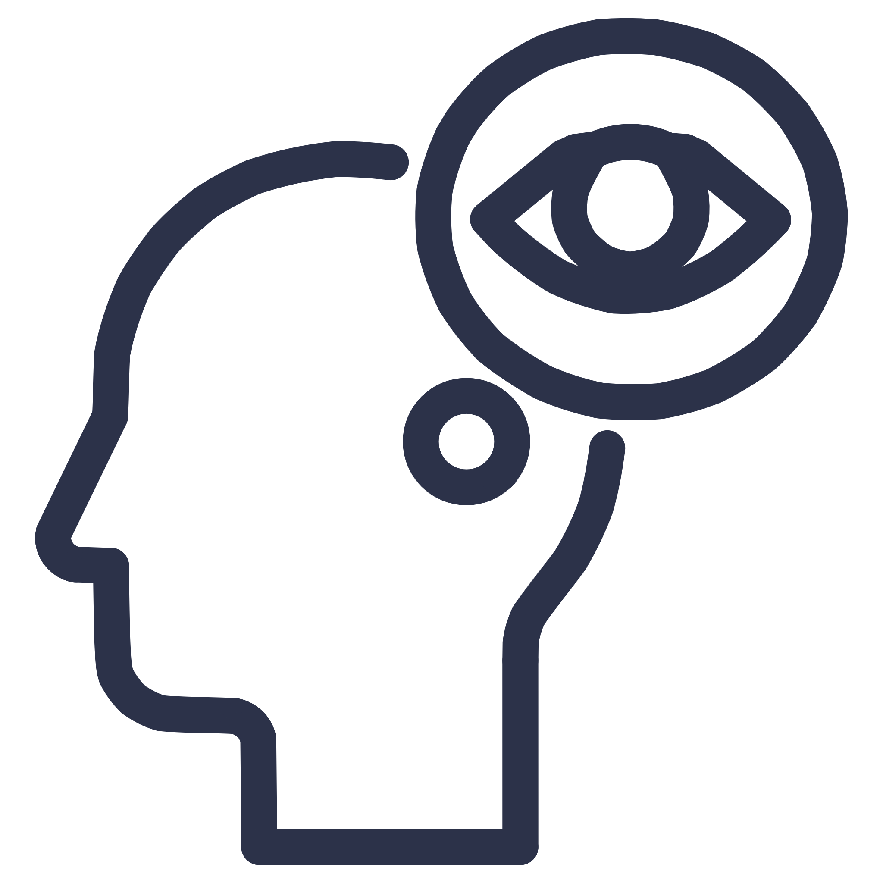


Our Proposed Solution: AI-Powered Detection
Capture Image
Preprocess Image
Take a picture of the potato leaf using a mobile phone or camera.
Resize and normalize the image to prepare it for the AI model.
Predict Disease
Display Results
An AI/Deep Learning model analyzes the image to predict the disease type.
The system tells the user if the leaf is healthy or identifies the disease, offering basic advice.

Slide 7

Dataset: Training the AI
Data Source
Images are sourced from publicly available datasets like Kaggle and other open-source repositories.
Image Quantity
Approximately 3,000 images were used to train and test the model.
Categories
Healthy
Early Blight
Late Blight
Train-Test Split
The dataset is divided into two parts: 80% for training the model and 20% for testing its accuracy on new, unseen images.

Slide 8




Technology Stack
Programming Language
Key Libraries
Python: Chosen for its rich ecosystem of AI/ML libraries and ease of use.
TensorFlow/Keras: For building and training deep learning models.OpenCV/Pillow: For efficient image handling and preprocessing.NumPy/Pandas/Matplotlib: For data manipulation and visualization.
Development Environment
Hardware
Jupyter Notebook/Google Colab: Interactive platforms for coding, experimentation, and model development.
Standard Laptop/GPU: Project can run on a typical laptop, with GPU support for faster training if available.

Slide 9
Model Working: Step-by-Step
Step 1: Collect Images
1
Gather potato leaf images from various sources, ensuring variety in lighting and angles.
2
Step 2: Preprocess Images
Resize images to a standard dimension.
Normalize pixel values (scale them from 0-255 to 0-1).
Step 3: Train Model
3
Apply data augmentation (rotate, flip) to increase dataset size and model robustness.
Use a Convolutional Neural Network (CNN) algorithm. Feed preprocessed images with their correct disease labels to teach the model.
4
Step 4: Test Model
Evaluate the trained model using a separate set of new, unseen images to check its prediction accuracy.
Step 5: Evaluate Performance
5
Analyze accuracy, identify misclassifications, and fine-tune the model for better results.

Slide 10
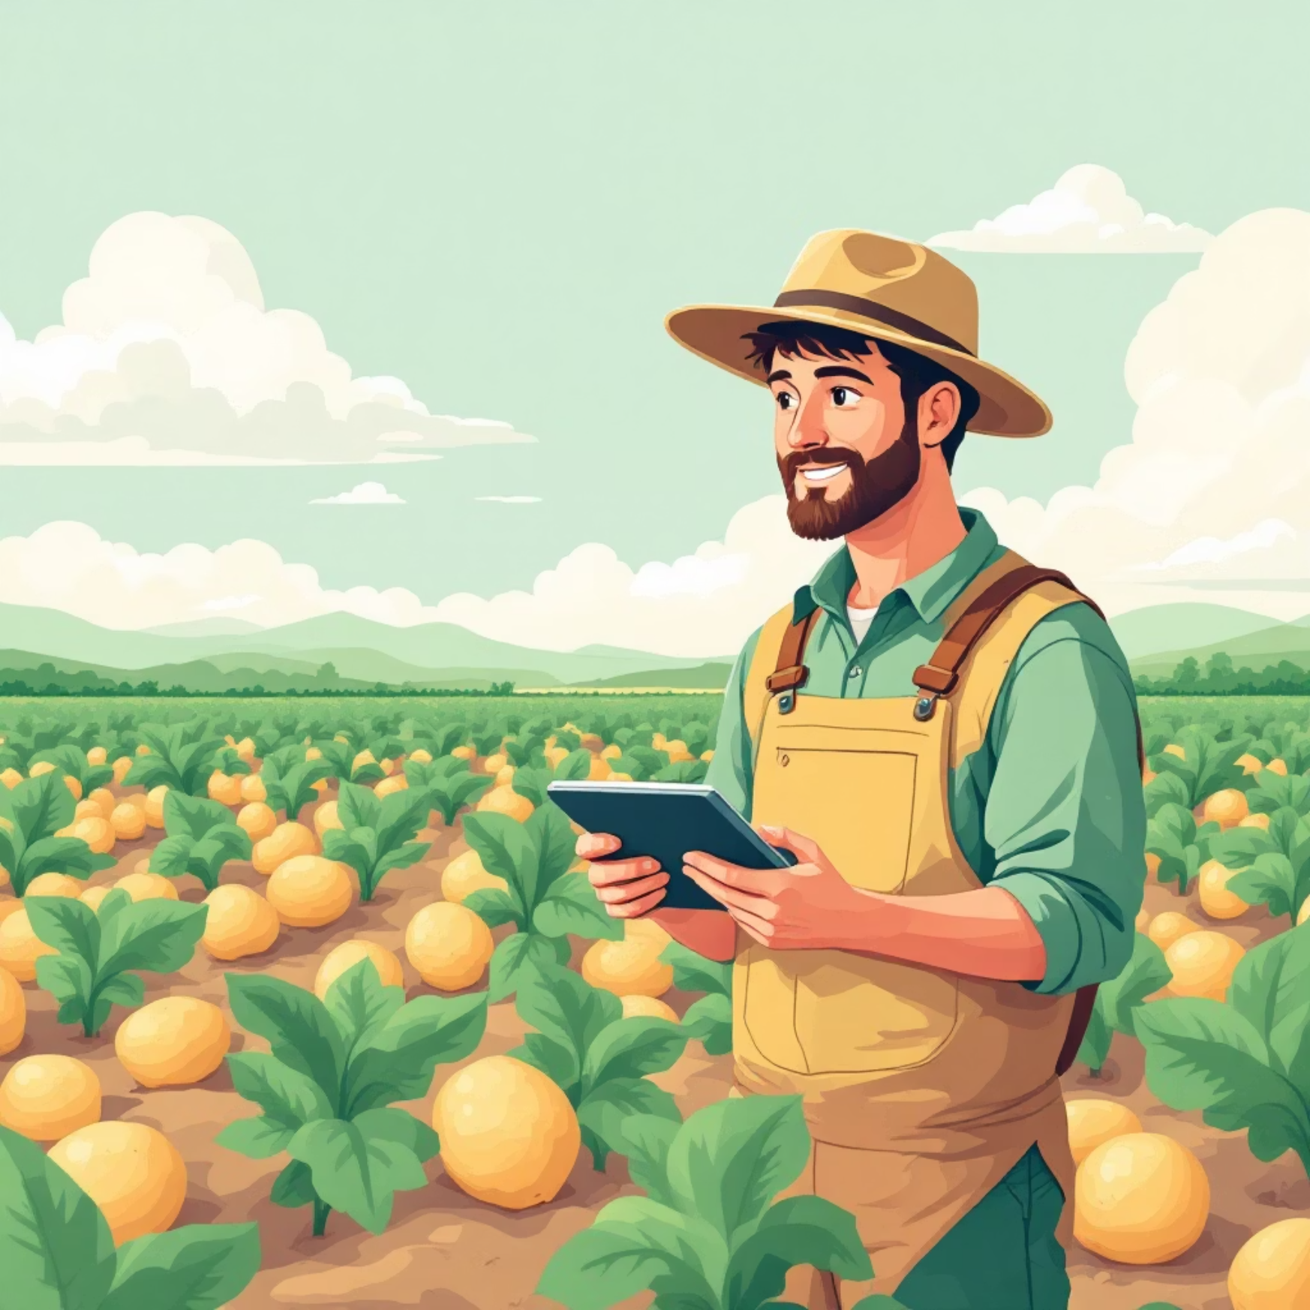
Conclusion: Towards Smart Agriculture
Our potato disease prediction project leveraging Machine Learning offers a promising solution for farmers. Early detection is key to reducing crop losses and maximizing yields.
ML-driven detection boosts agricultural efficiency.
Helps farmers save crops and financial resources.
Demonstrates the practical application of AI in modern farming.
This system is a small yet significant step towards fostering smarter, more sustainable farming practices globally.
Thank You
Any Questions?
ADITYA SINGHEnrollment: S24CSEU2779Bennett University, CSE, 3rd Semester

